Slide 1
Class Test Trial
COSMATT Accounting
Notes:
1

Slide 2
Table of Contents
Overview
Content
Requirements
Student / School Metadata
Question Navigator
Reports – Instructor View, Student View
Queries
Mocks
Student View
Instructor View
Notes:
2

Slide 3
Overview

Slide 4
Overview
Goal
To capture Student experience in context of the COSMATT Accounting Assessments (Problem Sets).
Plan
To setup a test bench where Students can take up Assessments based on questions from the existing set of questions available in the Accounting Course
Questions
This would ideally be a run of 15 – 20 mins including multiple Question types – MCQs and Leonardo Assessments
Capturing feedback:
Upon completion of the Assessment, Students would need to provide feedback on their experience / suggestions for improvement.
Evaluations
Student View: Student would be able to see this evaluation of Attempted Questions
Instructor View: Instructor would be able to review class evaluation and the student comments.

Slide 5
Content
Chapter 1: Section 1.1
Question 2 (net income) - MCQ
Question 3 (P and chart) - MCQ
Question 5 (business type) - MCQ
Chapter 1: Section 1.4
Question 1 (transactions) - MCQ
Question 2 (transactions) - MCQ
Chapter 1: Section 1.5
Assessment 1 (accounting equation grid) - Leonardo
Chapter 5: Section 5.2
Journalize only transactions 6/1 through 6/8 - Leonardo
Chapter 5: Section 5.5
Given a completed trial balance, prepare the three financial statements - Leonardo

Slide 6
Requirements
Access to the Question without any authentication
Home Page Contents should include the following
Institution Name – North Georgia University
Class – Dropdown (to be selected by the Student)
Student Name – Textbox (to be entered by the Student)
Student Email ID– Textbox (to be entered by the Student)
Date Time
Exam Duration
Question Navigator
8 Questions to include
All will be submittable exercises as in COSMATT.

Slide 7
Requirements
Comments / Feedback section
Capture feedback from the students at the end of exam after submitting the last question.
Reports / Dashboard (Student / Instructor View)
Student View
Question List along with Status of each Question
Time Spent
Instructor Dashboard for reviewing progress of all students? To be decided.
Basic Analytics of each student, one row per student
Question Counts – Correct, Incorrect, Unattempted

Slide 8
Queries
# | Query | Our Assumption
1 | Submit Option for each Question or only at the end of Test? | With each Question
2 | Instant feedback (Show Answer) on Submitting each Question? | Yes
3 | Is “Try Again” Option needed for each Question? | No. Only 1 attempt per Question
4 | Will it be a timed test? Does time need to be tracked per Question or is it ok to have total time for the exam? | No. Time tracking will be done but no time limit will be added Time tracking for Exam not for Question
5 | Report Status? | No scores. Only Correct, Incorrect and Unattempted will be shown for both Student and Instructor View
6 | Should capturing Student Comments/Feedback be mandatory? | Yes. Not at Question level but at the exam level. Upon Submitting the feedback only, the student gets access to report.
7 | Name of the Exam, School and Class Name to be used on home page | Title Options: COSMATT Accounting Lab / Exam / Questions Experience COSMATT Accounting Experience Trial COSMATT Extra Credit Questions
8 | Any other parameters to be captured? | ?

Slide 9
Mocks

Slide 10
Student Workflow

Slide 11
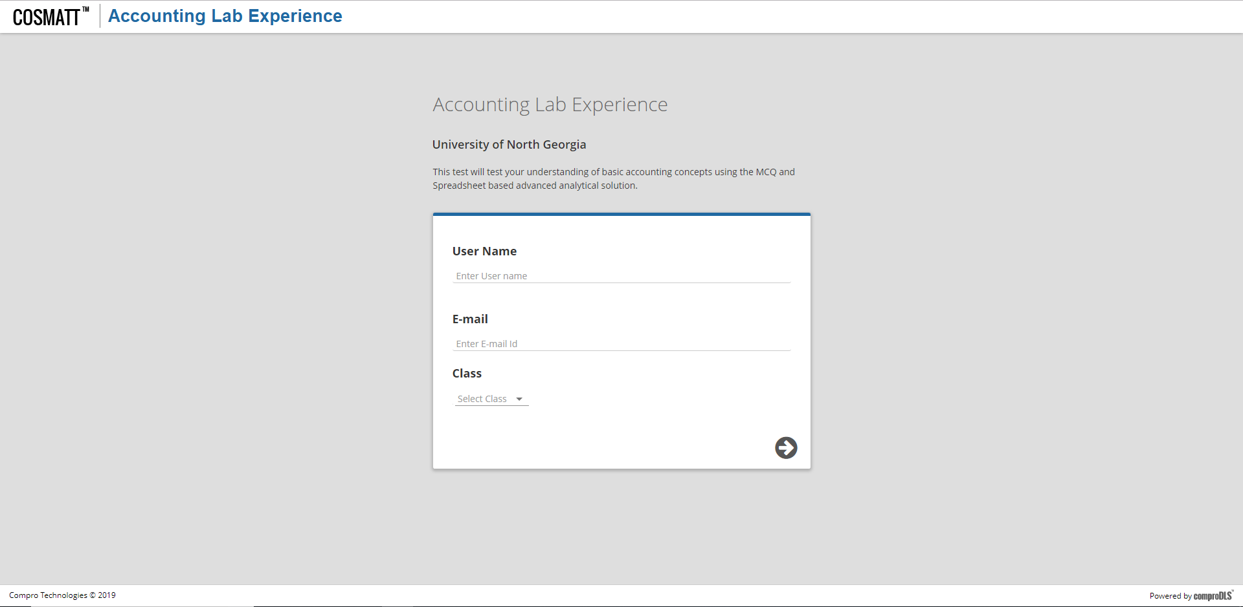
Mocks – Landing Page

Slide 12
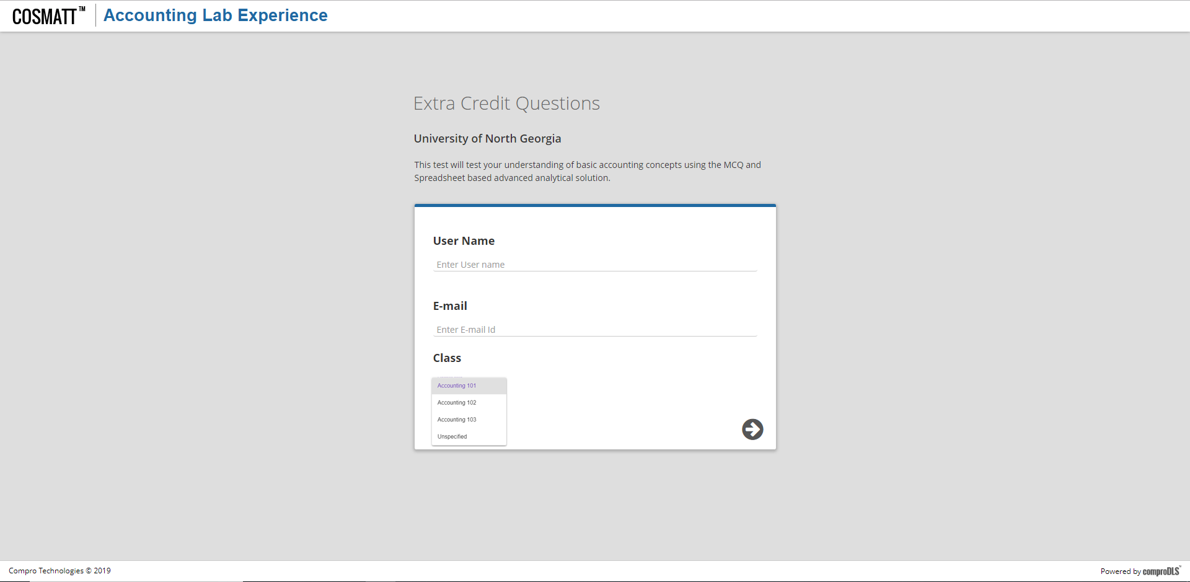
Mocks – Landing Page

Slide 13
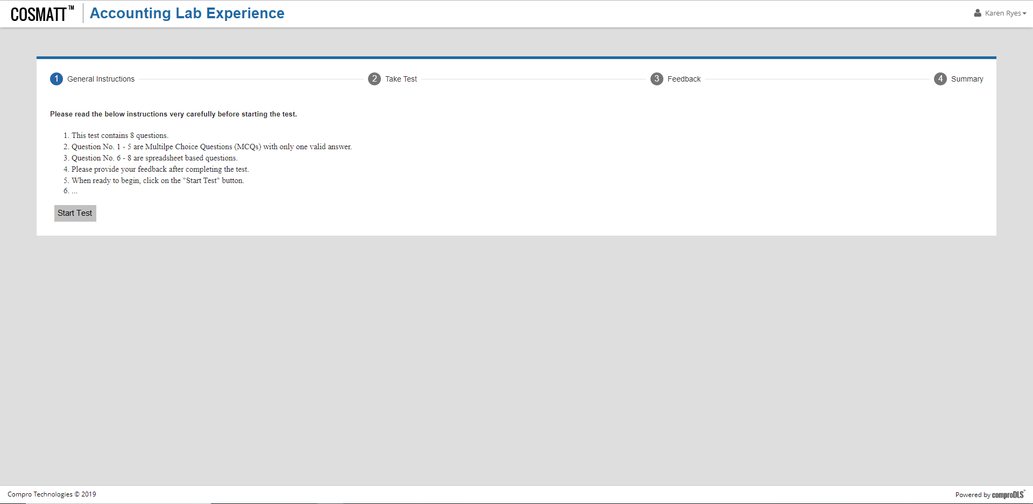
Mocks – Home Page

Slide 14
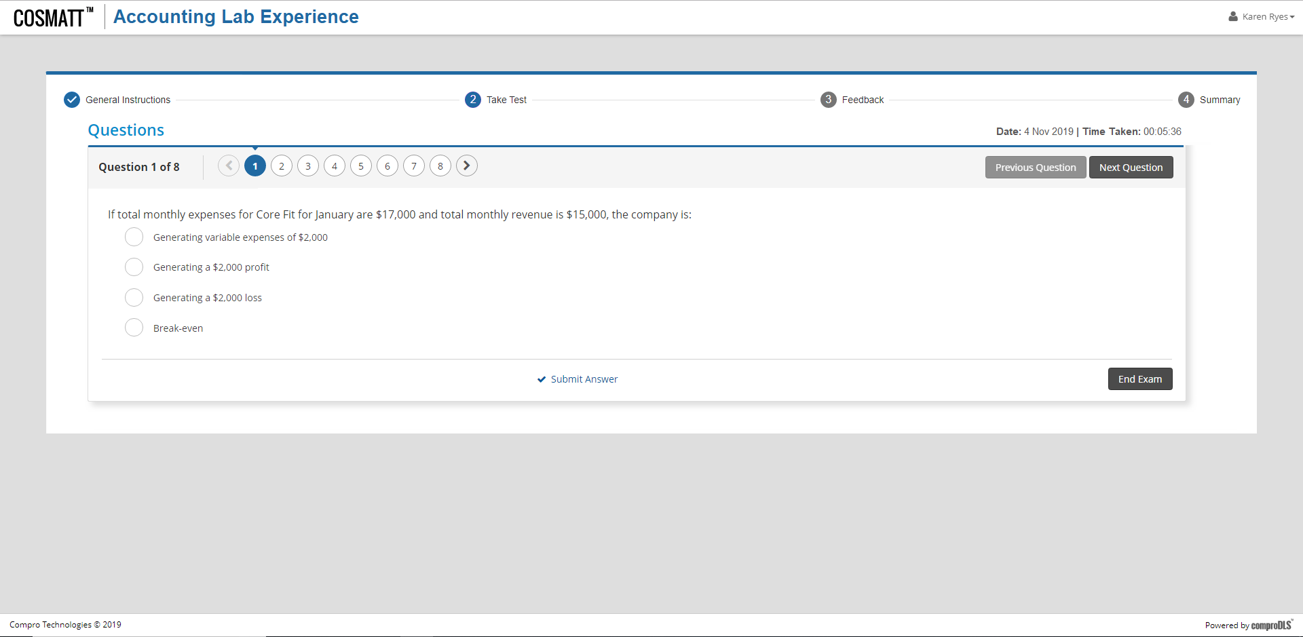
Mocks – Question Navigator

Slide 15
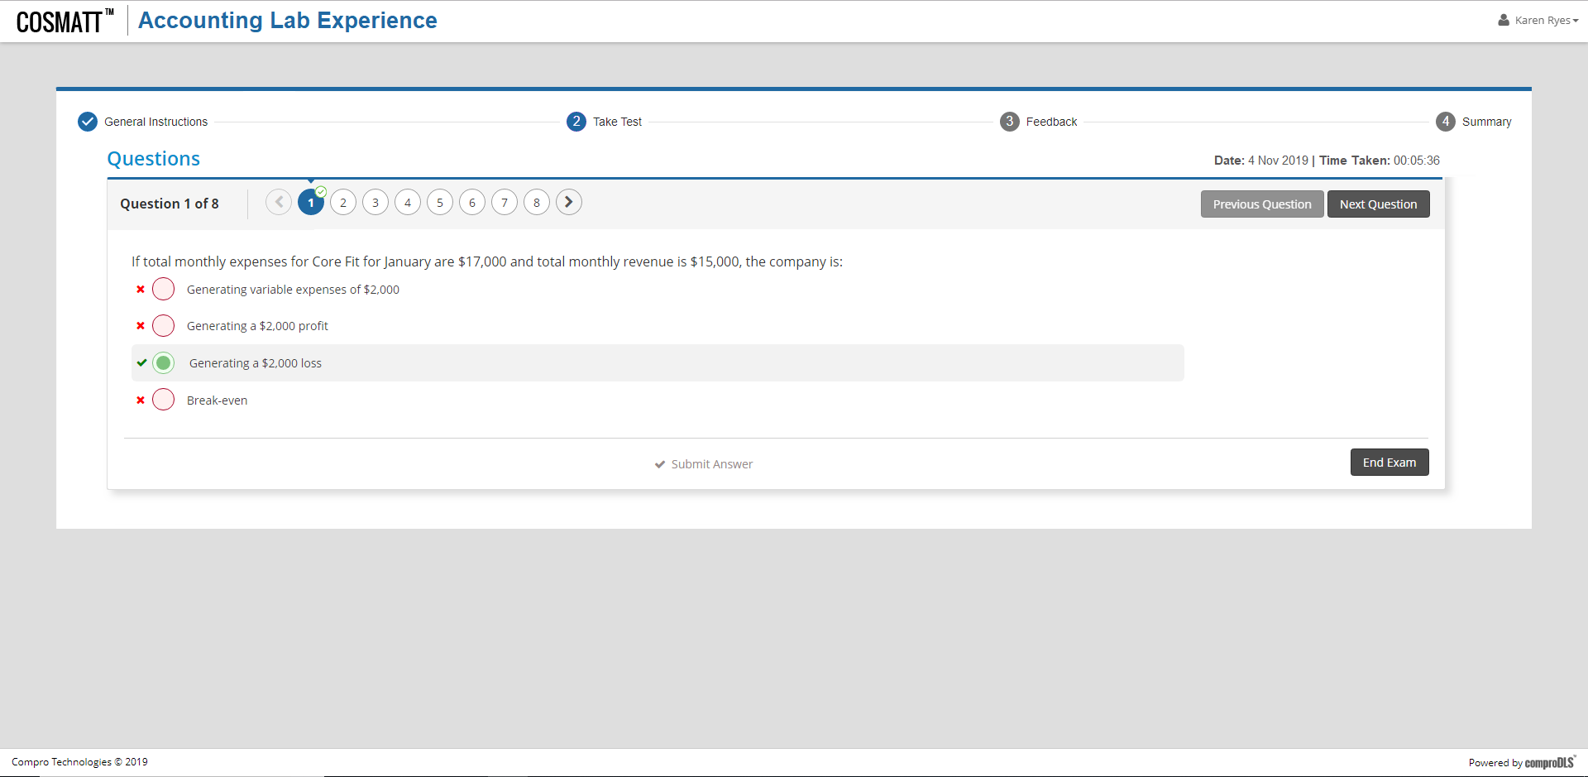
Mocks – Question Navigator

Slide 16
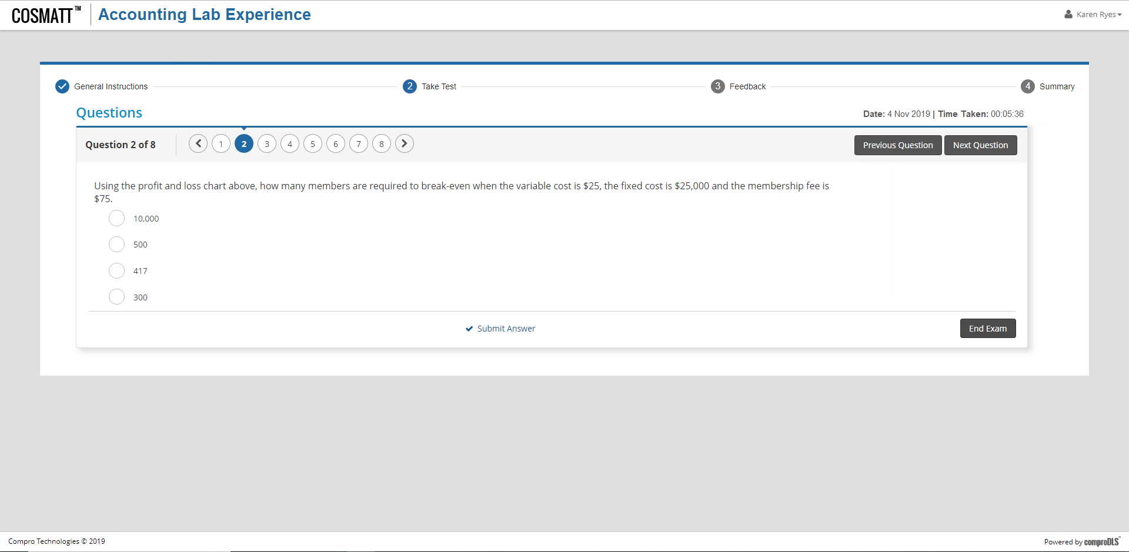
Mocks – Question Navigator

Slide 17

Mocks – Question Navigator

Slide 18
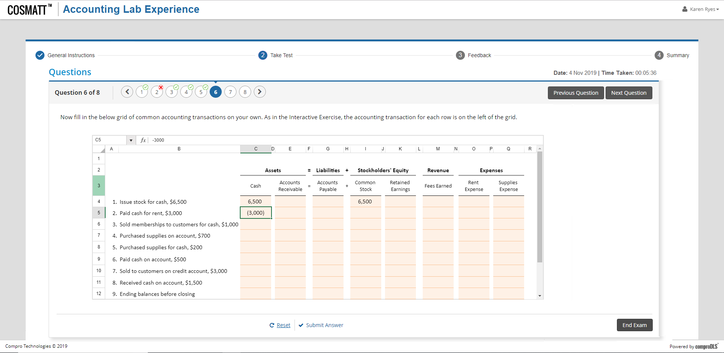
Mocks – Question Navigator

Slide 19
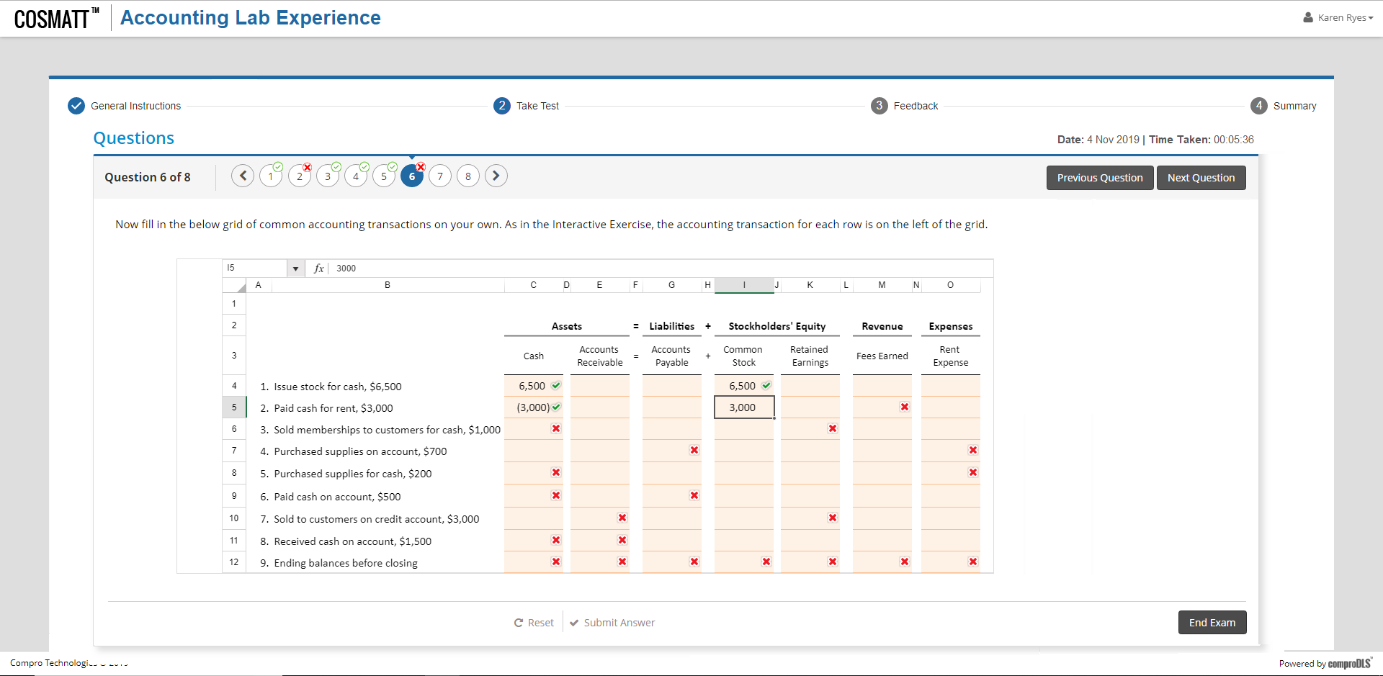
Mocks – Question Navigator

Slide 20
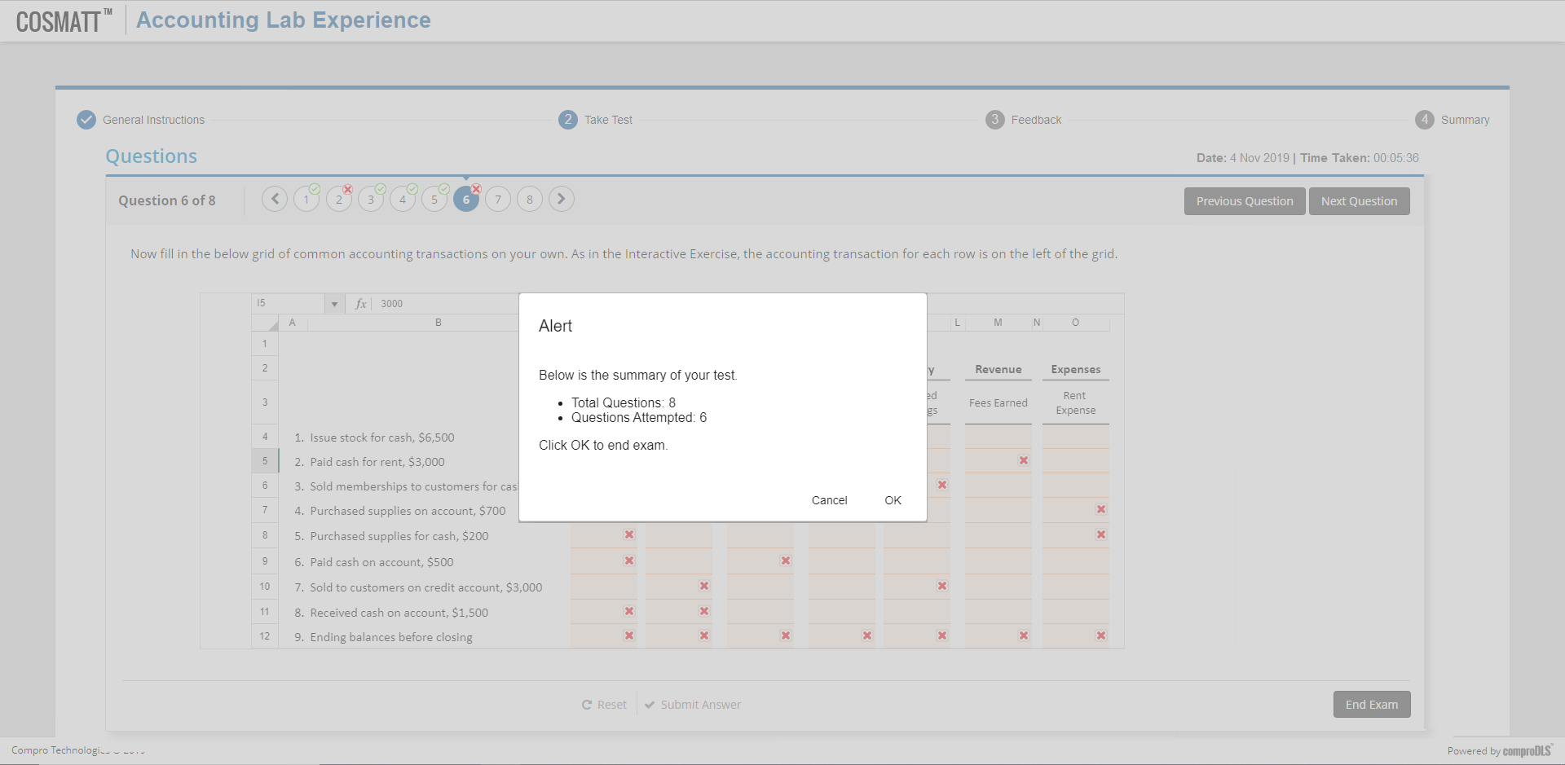
Mocks – Question Navigator

Slide 21
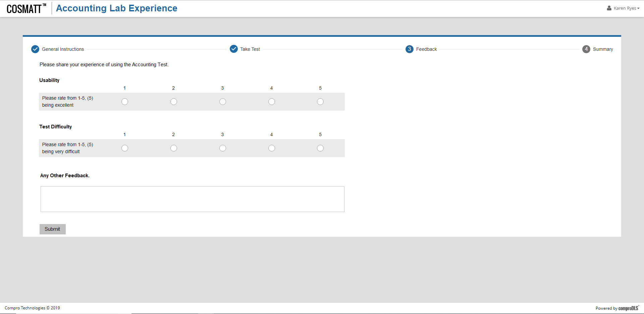
Mocks – Feedback

Slide 22
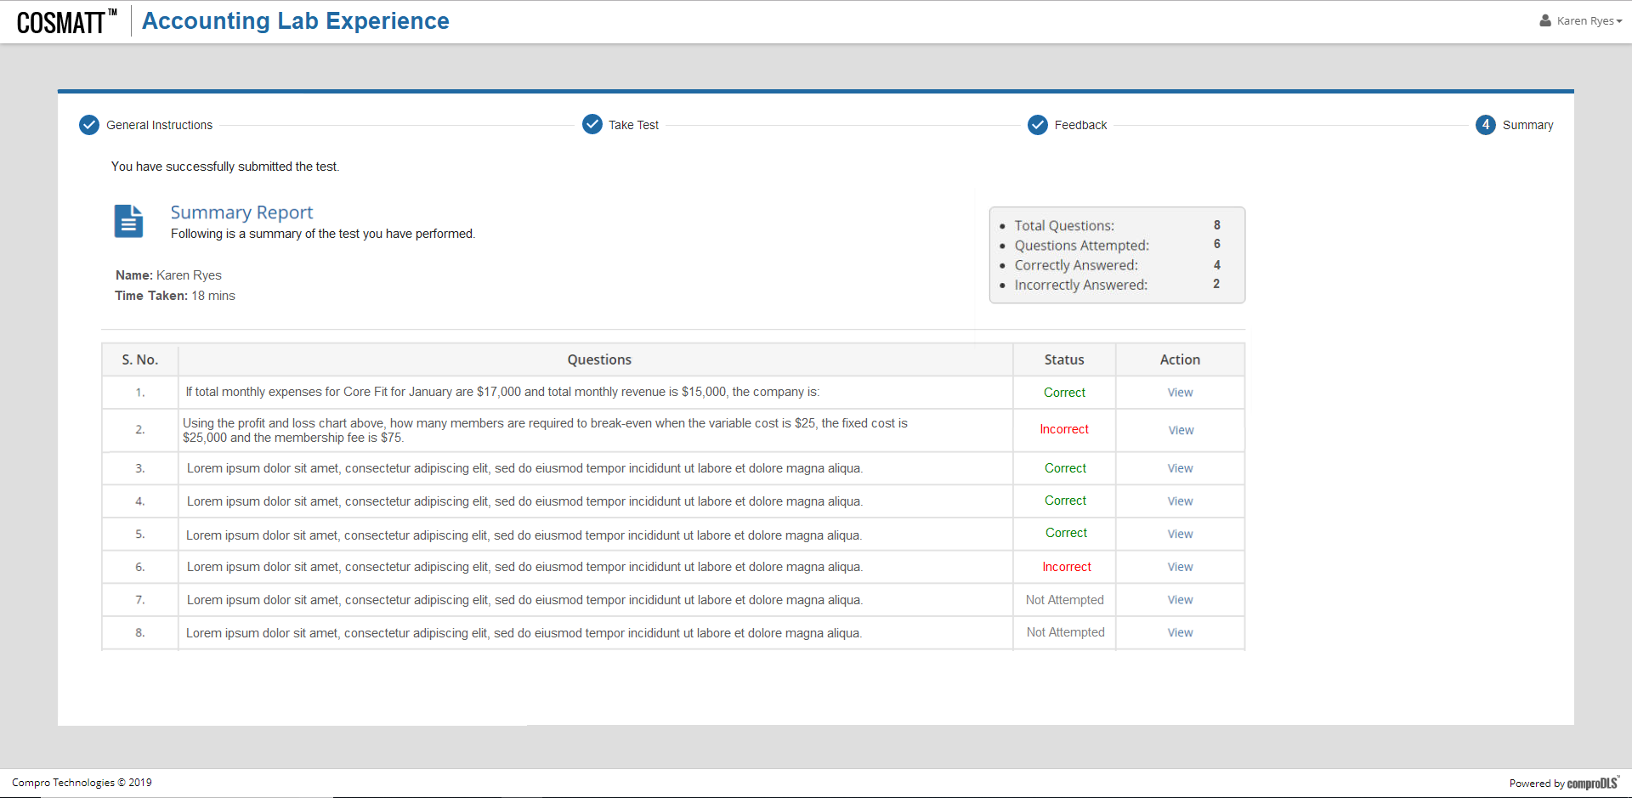
Mocks – Report

Slide 23
Instructor Workflow

Slide 24

Mocks – Home Page

Slide 25
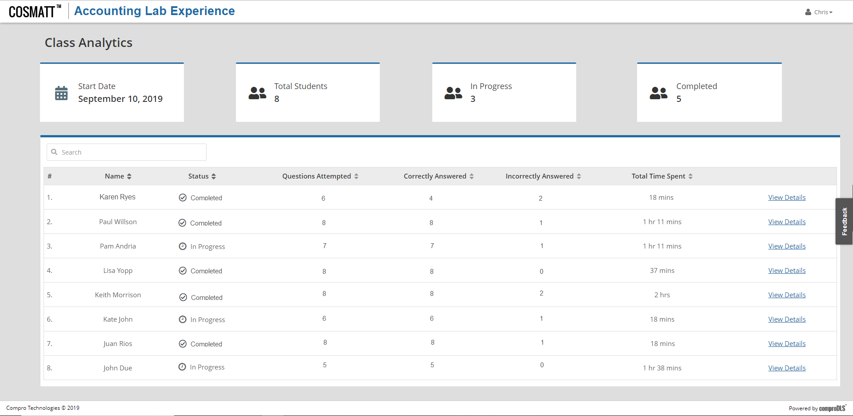
Instructor View - Reports

Slide 26
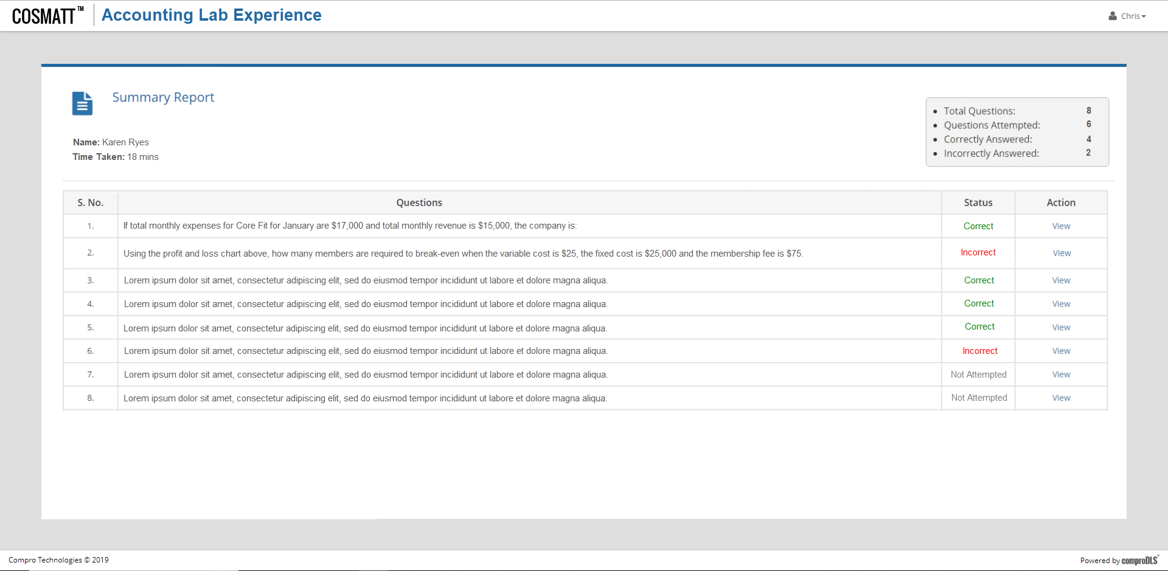
Instructor View - Reports

Slide 27
End Of Presentation
Notes:
27

Slide 28
Option 2: COSMATT Based
Questions as sections
Questions as a Test Your Understanding Widget
Questions along with Narrative

Slide 29
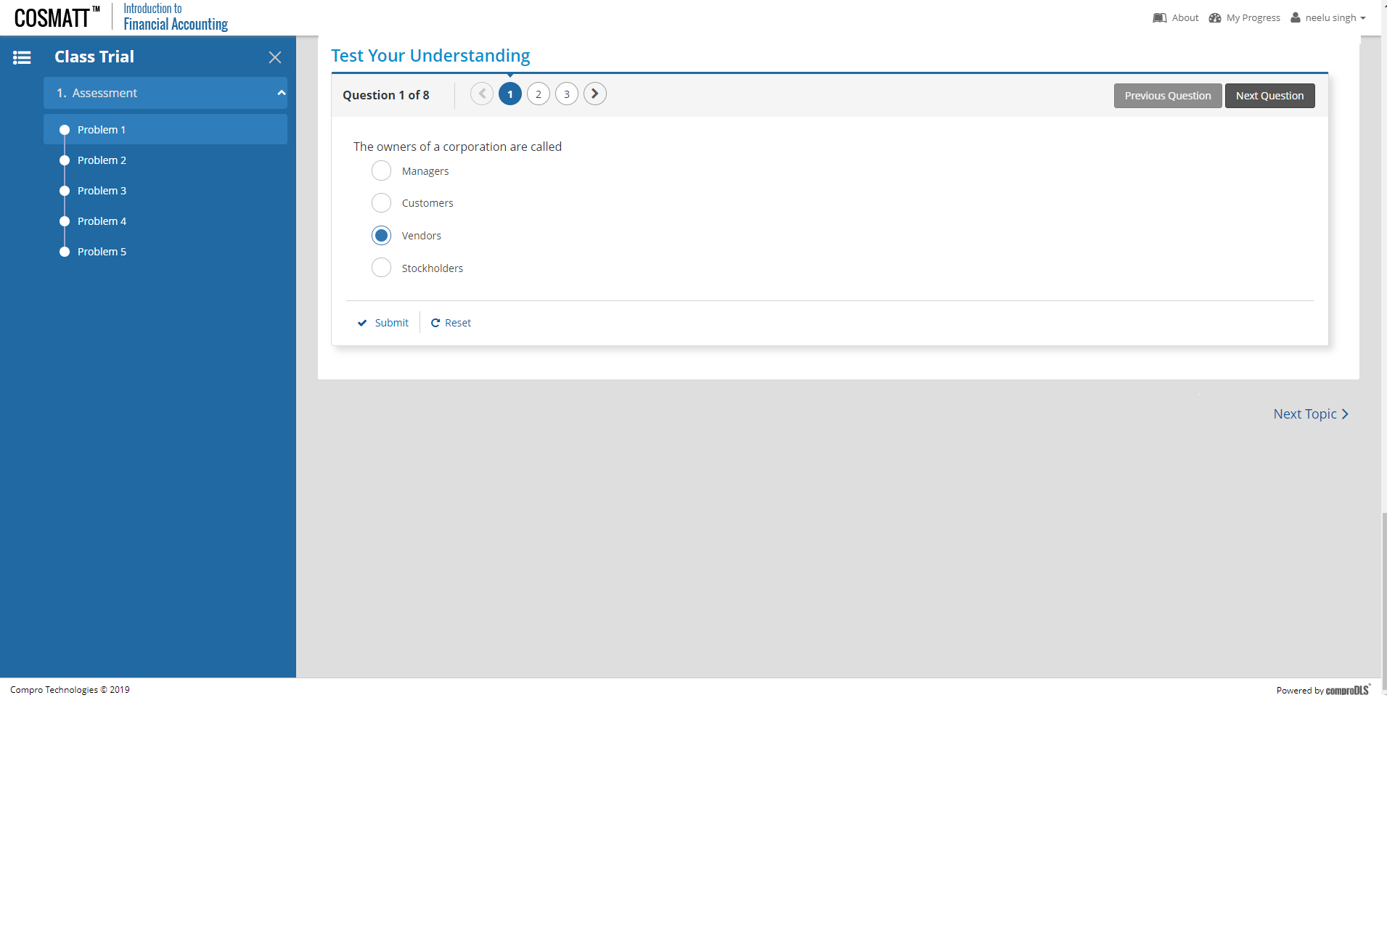
Option 2a: Questions as sections

